Slide 1



Made this happen with

Slide 2
Android Architecture Components
Sanath Nandasiri
☺

Slide 3
Why architecture components?
Well architected app should have
Separation of Concerns
Aliened with SOLID Principles.
Well tested patterns MVC, MVP,MVVM or Your own solution (may be XYZ ☺)
This will make sure, your app’s
Simplicity
Reusability
Scalability
Upgradability
Manageability
Testability
Maintainability

Slide 4
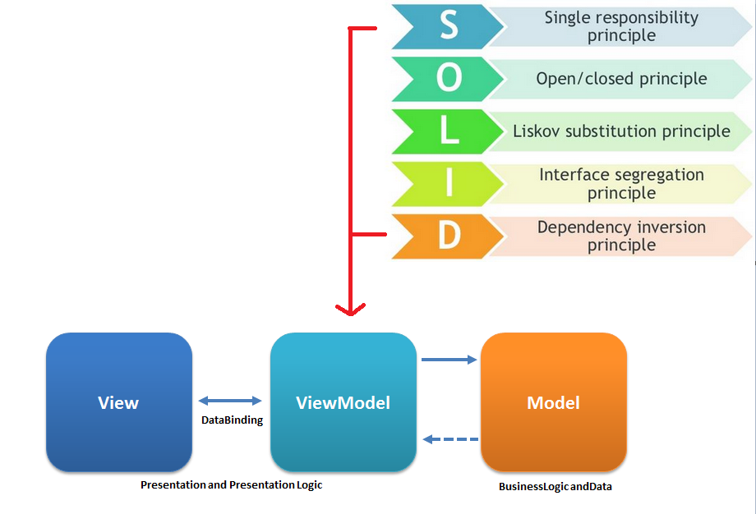
And Android Like MVVM

Slide 5
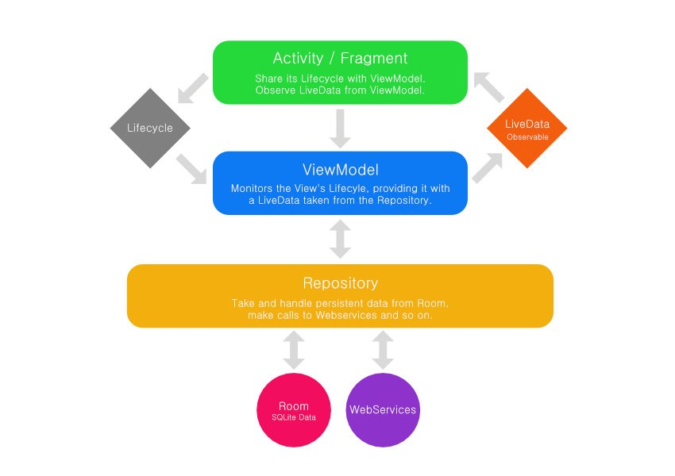
What they recommends…
View
ViewModel
Model

Slide 6
What are the components
Lifecycle / Lifecycle Owner / Lifecycle Observer
https://developer.android.com/topic/libraries/architecture/lifecycle.html
LiveData
https://developer.android.com/topic/libraries/architecture/livedata.html
ViewModel
https://developer.android.com/topic/libraries/architecture/viewmodel.html
Room
https://developer.android.com/topic/libraries/architecture/room.html

Slide 7
Lifecycle
Lifecycle Owner
Android components with lifecycle (Activities and Fragment)
Lifecycle Observer
Classes that observe lifecycle State/Event of Lifecycle Owner.
Event
Lifecycle event that match with respective event of Lifecycle Owner
State
Current state of Lifecycle Owner

Slide 8
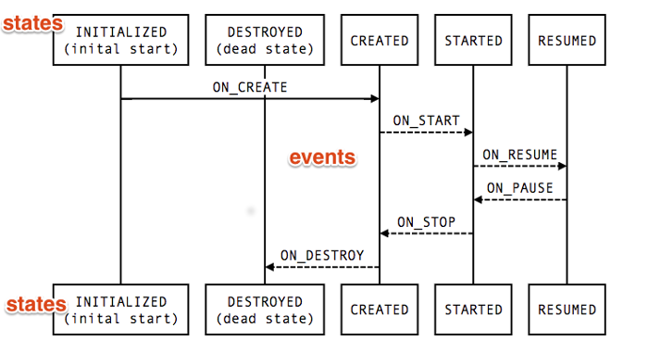
Lifecycle

Slide 9
Enough talk, show something …
Sure… ☺

Slide 10
So, With Lifecycle
You can code where it should be…
State management can be handle internally.
No hook to Activity or Fragment lifecycle methods.
Makes Activity and Fragments lean as possible...

Slide 11
Living with LiveData<>
It is an Observable lifecycle-aware data holder.
Updates only when attached to active observer(s).
Get up-to-date with configuration changes.
Is removed when Lifecycle Owner destroyed.
But, not retained same state on configuration change ☹.

Slide 12
LiveData<> vs MutableLiveData<>
LiveData not changing it’s state after creating it.(Immutable)
Use MutableLiveData<> to updatevalue
postValue(T value) from background.
setValue(T value) from MainThread.
MutableLiveData<> extends LiveData<>.

Slide 13
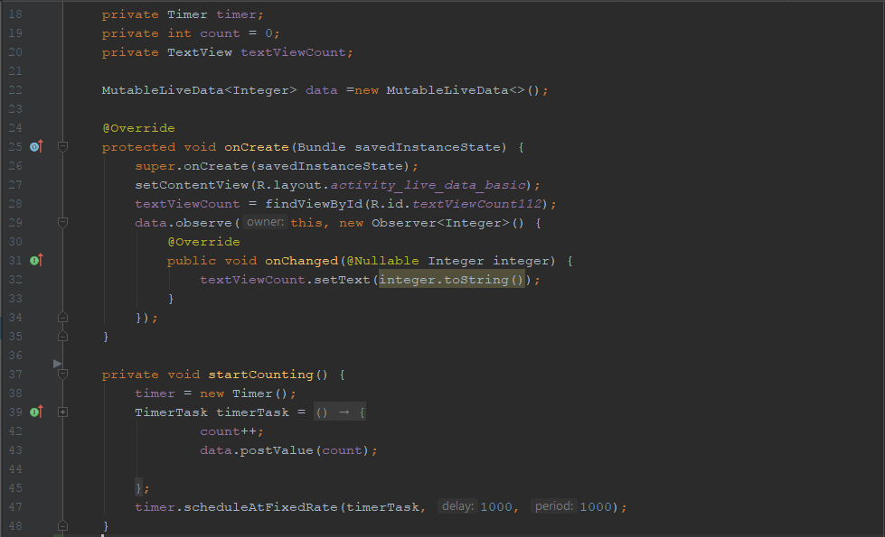
LiveData<> vs MutableLiveData<>

Slide 14
Demo…
Ok… ☺

Slide 15
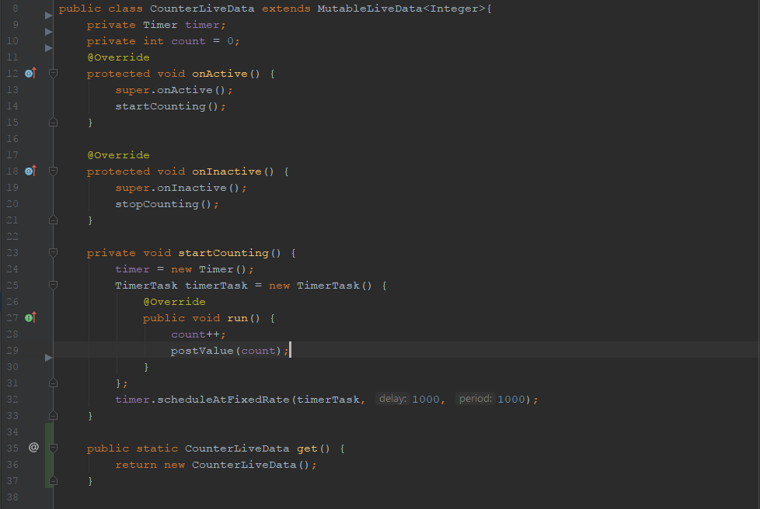
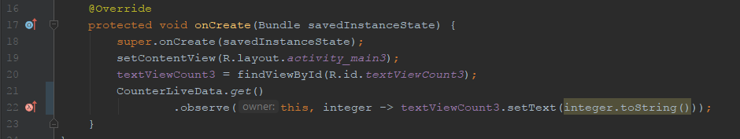
I need my own LiveData<>

Slide 16
Can I see that…?
Yep… ☺

Slide 17
Transform LiveData<>
To make changes to LiveData before dispatch to observe.
Get new LiveData based on another.
Transformations .map(LiveData<X> source, Function<X, Y> func)
LiveData<Integer> length = Transformations.map(input, input -> input != null ? input.length() : 0);
Transformations. switchMap(LiveData<X> trigger, Function<X, LiveData<Y>> func)
LiveData<String> capital = Transformations.switchMap(input, this::getCapitalized);

Slide 18
Shall we transform something …
May be later…☺

Slide 19
Wait, Is RxJava and LiveData same ?
No.
LiveData is Holder holds last value…
If Rx is Universe, LiveData is Earth attached to Lifecycle
Not our lifecycle, I mean Android ☺
Google says,
Use LiveData in View ---> ViewModel communication.
Use Rx in ViewModel ---> Model communication (Repository Pattern).
Use android.arch.persistence.room:rxjava2

Slide 20
Did you check Configuration change…
$#!+ happens ☹

Slide 21
ViewModel save me…
Store and manage UI-related data in a lifecycle conscious way.

Slide 22
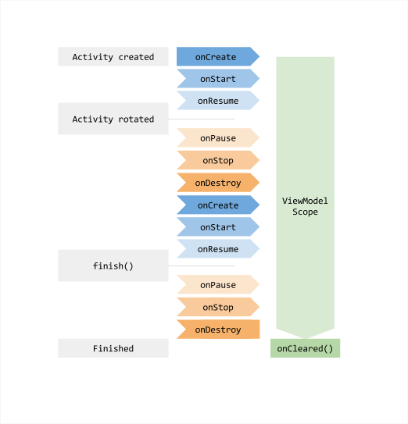
ViewModel vs Lifecycle

Slide 23
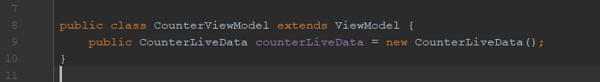
ViewModel implementation

Slide 24
Demo…
Yes, more to show…☺

Slide 25
Well, with the ViewModel…
It will hold data for UI (Activity or Fragment)
Survive on Configuration change.
Clear itself when UI get destroyed completely.
Can share view model within Fragments
Don’t refer View or Activity context inside ViewModel.
Use AndroidViewModel when context needed.
For System services.
AndroidViewModel provides Application context.

Slide 26
Now, We need M part of MVVM
Of course we need database layer for Model
Repository and Data source.
If it support offline.

Slide 27
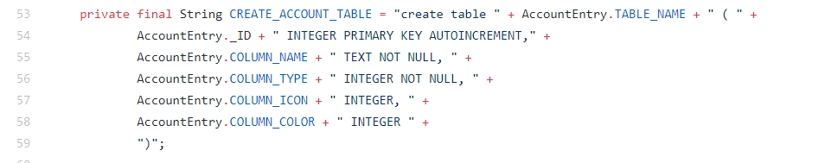
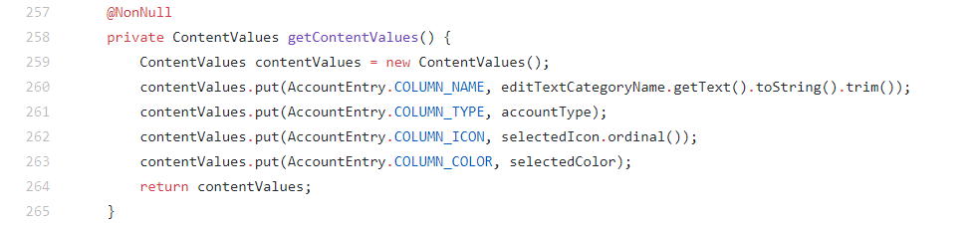
Remember the past…

Slide 28
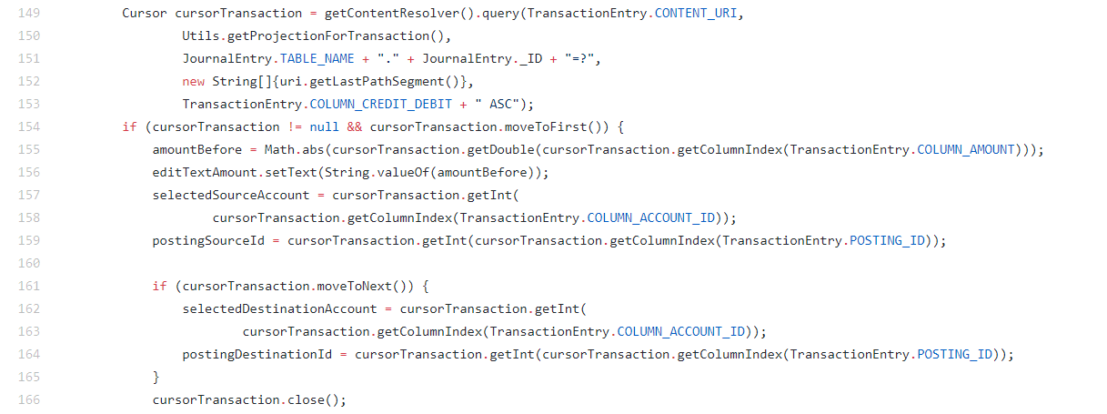
Remember the past…

Slide 29
But, Why ?…
Don’t need lot of boilerplate code.
SQL
Compile time verification, nice to have ☺

Slide 30
Meet Room…
Object Relational Mapper For SQLite.
Is this the only one out there? No
OrmLite
SugarORM
GreenDAO

Slide 31
So, Why Room…
It has compile time verification.
Less boilerplate
Full integration with LiveData.
RxJava support
No Lazy loading 😐

Slide 32
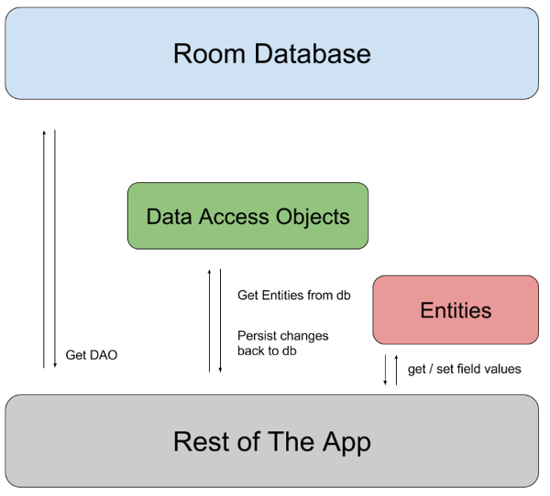
Rooms’ way…

Slide 33
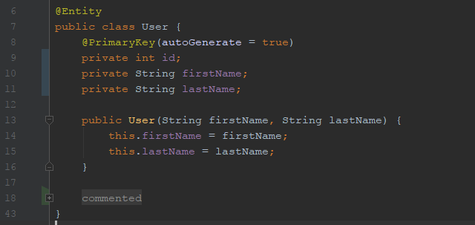
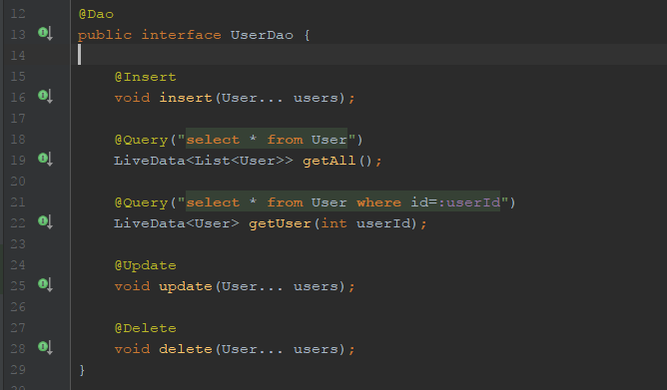
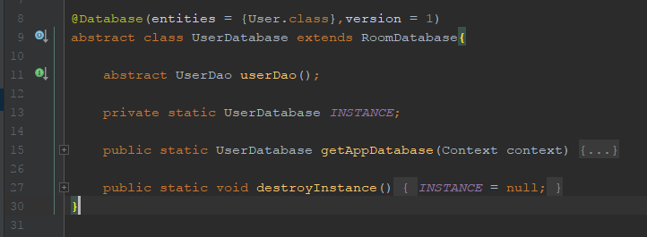
Let’s create data access layer…

Slide 34
Is that all?
Yes, Let’s have a look ☺

Slide 35
Android Architecture…
Activity/ Fragment
View
ViewModel
ViewModel
Dagger
Repository
Model
Datasource

Slide 36
Android Architecture…
Testing
Testing Framework | Layer | Mock
Android Instrumentation | Activity/ Fragment | Mocked ViewModel
Android JUnit | ViewModel | Mocked Repository
Android JUnit | Repository | Mocked Datasource

Slide 37
Android Architecture…
Use Dagger for Dependency Injection.
Use ButterKnife or Android Databinding for UI.
Use Retrofit for remote data source.
Use RxJava manage data streams in Repository.

Slide 38
Have a look…
References.
https://github.com/googlesamples/android-architecture
https://developer.android.com/topic/libraries/architecture/index.html
https://google.github.io/dagger/android
http://jakewharton.github.io/butterknife/
https://developer.android.com/topic/libraries/data-binding/index.html
http://square.github.io/retrofit/
Slides and Source code.
https://goo.gl/4fHBCH

Slide 39
Q and Gifts from Me
☺

Slide 40
Q and A
😐

Slide 41
More Q
Twitter @sanathnandasiri
Mail sanathe06@gmail.com

Slide 42

Thank you every one.
☺

